Slide 1
THERMIONIC VALVE
Dr Kapil Garg
Dept. Of Musculoskeletal Physiotherapy
MGM Institute Of Physiotherapy
Chh. Sambhajinagar

Slide 2
thermionic valve
It uses the phenomenon of thermionic emission of electrons from a hot cathode and is used for a number of fundamental electronic functions such as signal amplification and current rectification. Non-thermionic types, such as a vacuum phototube however, achieve electron emission through the photoelectric effect, and are used for such purposes as the detection of light intensities. In both types, the electrons are accelerated from the cathode to the anode by the electric field in the tube.

Slide 3
Diodes
The diode vale is the most basic of all thermionic or vacuum tube devices having only two active electrodes, nevertheless it is still an important component whose operation needs to be understood if other forms of vacuum tube or thermionic valve technology are to be comprehended.
.

Slide 4
The most basic form of diode valve or vacuum tube is the diode. It consists of two conducting electrodes that are contained within an evacuated glass envelope. These are named the cathode and anode.

Slide 5
A diode is a two-terminal electronic component that conducts current primarily in one direction (asymmetric conductance); it has low (ideally zero) resistance in one direction, and high (ideally infinite) resistance in the other. A diode vacuum tube or thermionic diode is a vacuum tube with two electrodes, a heated cathode and a plate, in which electrons can flow in only one direction, from cathode to plate.

Slide 6
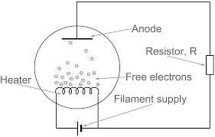
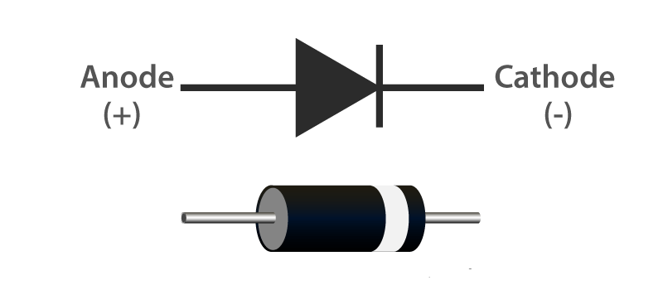

Slide 7
A semiconductor diode, the most commonly used type today, is a crystalline piece of semiconductor material with a p–n junction connected to two electrical terminals. Semiconductor diodes were the first semiconductor electronic devices. The discovery of asymmetric electrical conduction across the contact between a crystalline mineral and a metal was made by German physicist Ferdinand Braun in 1874. Today, most diodes are made of silicon, but other materials such as gallium arsenide and germanium are used.

Slide 8
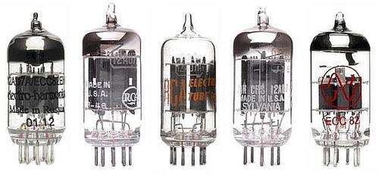

Slide 9
Triode
A triode is an electronic amplifying vacuum tube consisting of three electrodes inside an evacuated glass envelope: a heated filament or cathode, a grid, and a plate (anode). Developed from Lee De Forest's 1906 Audion, a partial vacuum tube that added a grid electrode to the thermionic diode (Fleming valve), the triode was the first practical electronic amplifier and the ancestor of other types of vacuum tubes such as the tetrode and pentode. Its invention founded the electronics age, making possible amplified radio technology and long-distance telephony.

Slide 10
Triodes were widely used in consumer electronics devices such as radios and televisions until the 1970s, when transistors replaced them. Today, their main remaining use is in high-power RF amplifiers in radio transmitters and industrial RF heating devices. In recent years there has been a resurgence in demand for low power triodes due to renewed interest in tube-type audio systems by audiophiles who prefer the sound of tube-based electronics.

Slide 11
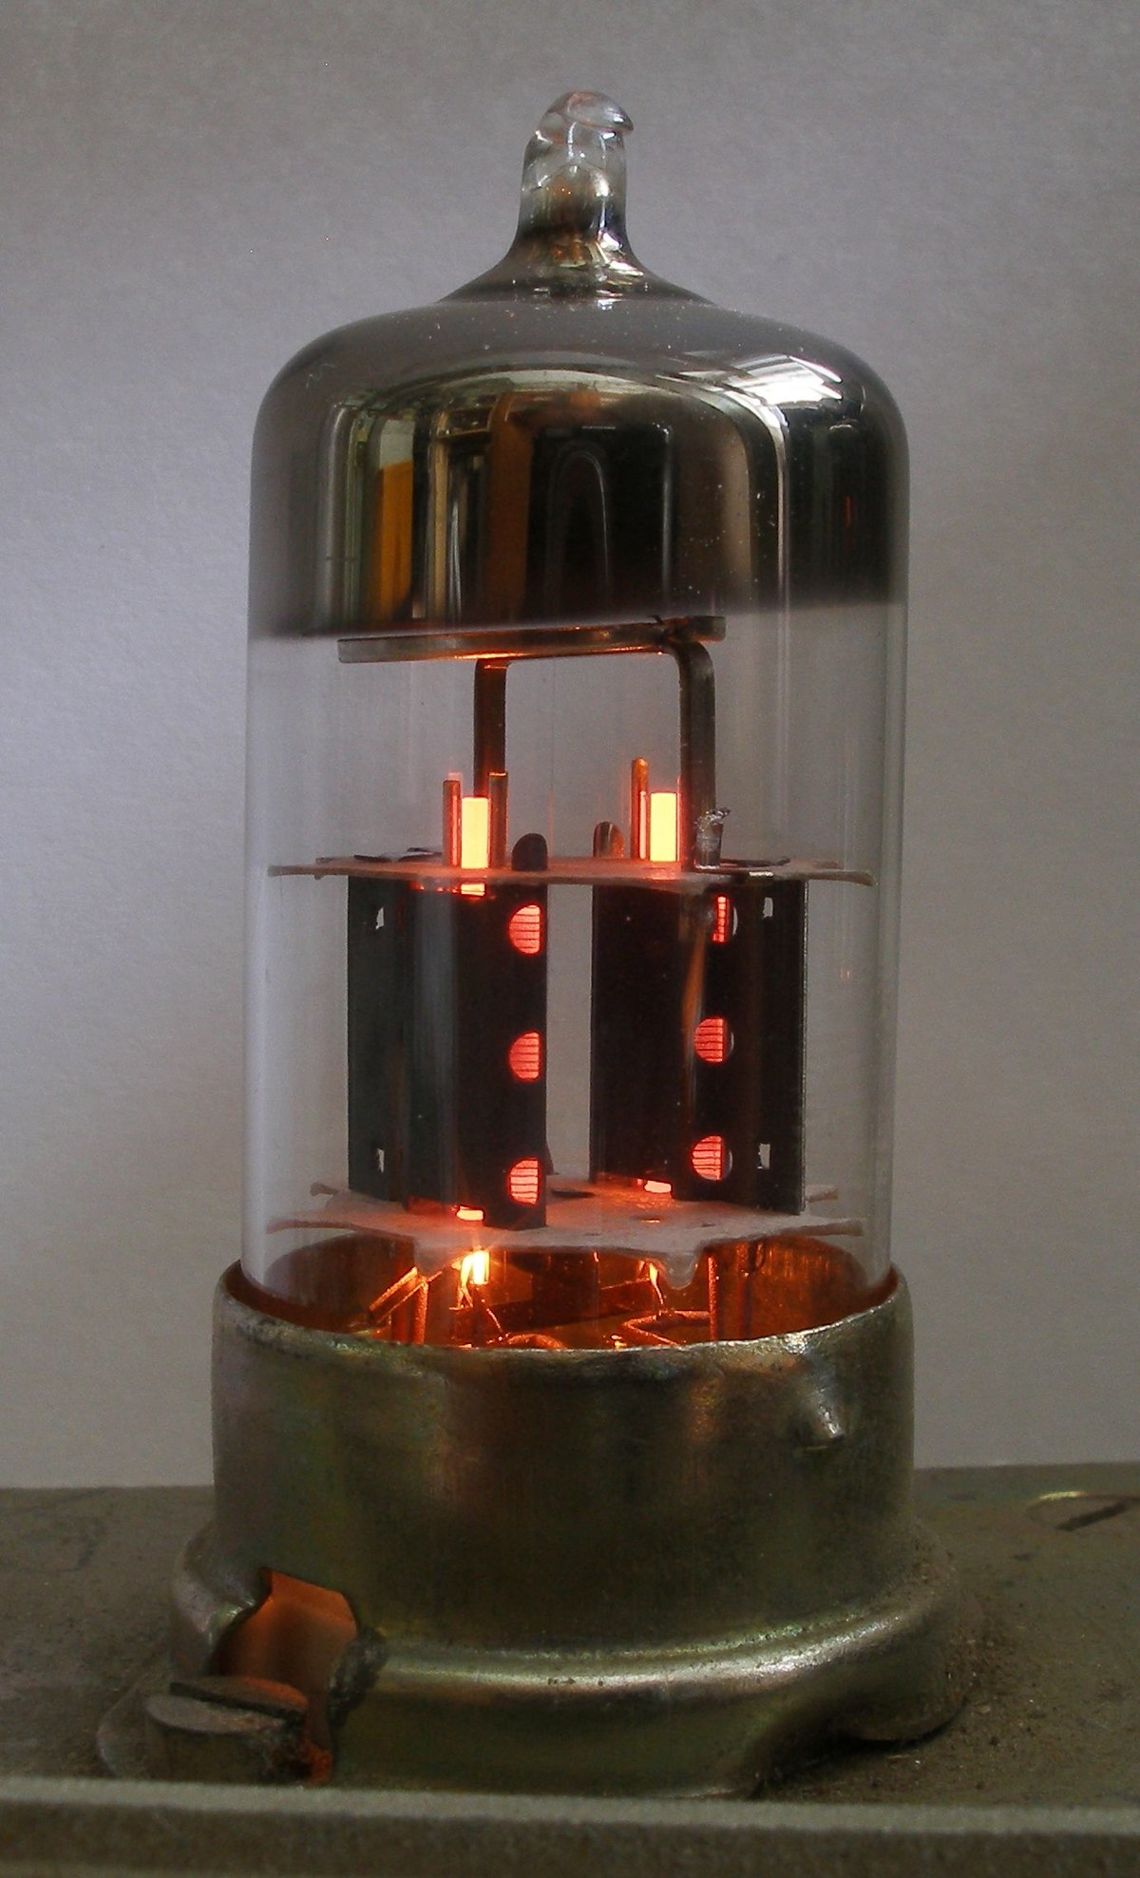
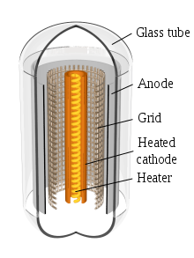

Slide 12
THANK YOU

